Slide 1
ON THE PHYSICALLY POSSIBLE REGION FOR THE STABILITY OF THE 3D VARIABLE-HEIGHT INVERTED PENDULUM FOR PUSH RECOVERY WITH CAPTURE POINT USING FIXED AND VARIABLE COP
GABRIEL ENRIQUE GARCÍA CHÁVEZ
2019

Slide 2

Model of the 3D VHIP
No angular momentum.
$$\dot{L}=f_{gr}×\left(r−r_{P}\right)=0$$
$f_{gr}$: Reaction Force of the ground.
$r$: Position of the CoM
$r_{P}$: Position of the CoP
Force parallel to $r−r_{P}$.
$$f_{gr}=mu\left(r−r_{P}\right)$$
$m$: Mass of the robot
$u:$ New control input holding:
$$u=\frac{\left\|f_{gr}\right\|}{m\left\|r−r_{p}\right\|}$$

Slide 3

Model of the 3D VHIP
Dynamics of the CoM:
$$m\ddot{r}\left(t\right)=f_{gr}−mg$$
$$\ddot{r}\left(t\right)=u\left(r−r_{P}\right)−g$$
$$\left\{\begin{aligned}\ddot{x}=u(x−x_{P}) \\ \ddot{y}=u(y−y_{P}) \\ \ddot{z}=u\left(z−z_{P}\right)−g\end{aligned}\right.;u≥0$$

Slide 4
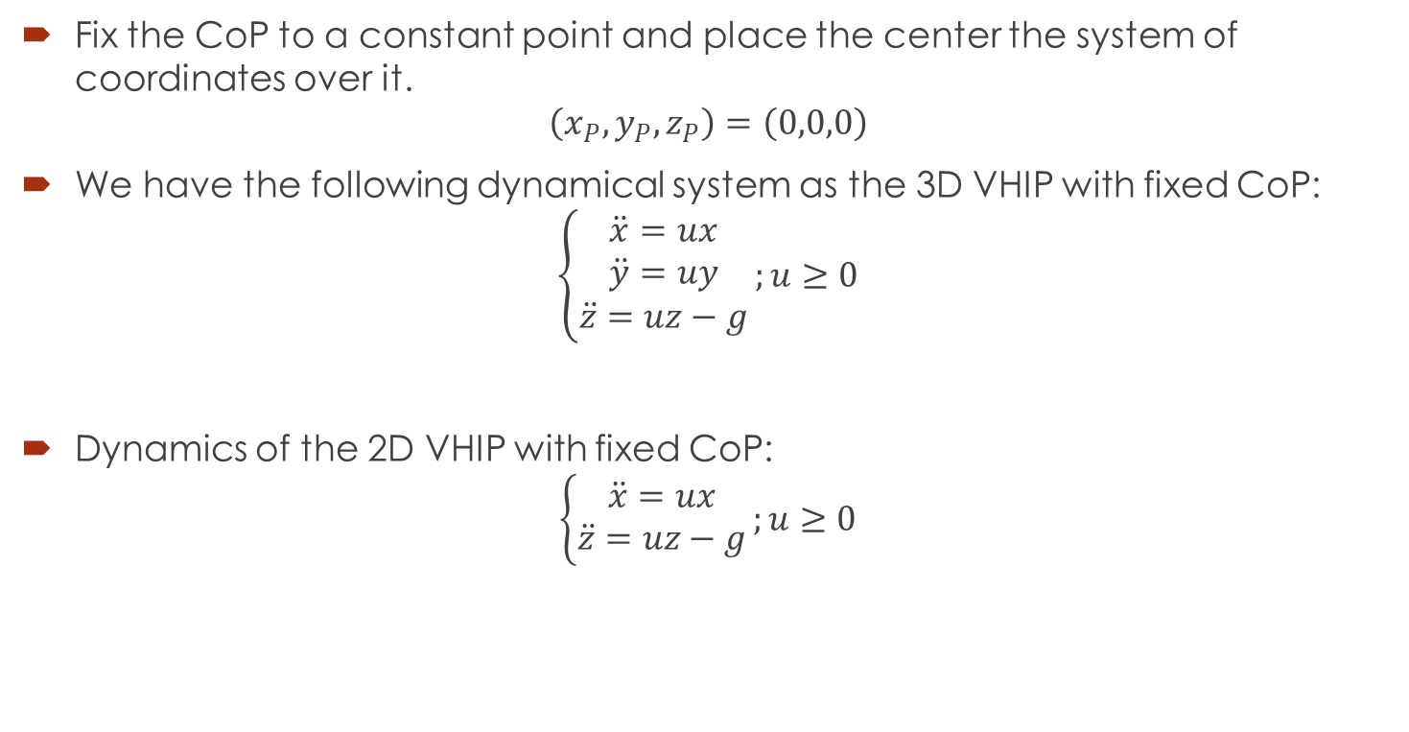
3D VHIP with Fixed CoP
Fix the CoP to a constant point and place the center the system of coordinates over it.
$$\left(x_{P},y_{P},z_{P}\right)=\left(0,0,0\right)$$
We have the following dynamical system as the 3D VHIP with fixed CoP:
$$\left\{\begin{aligned}\ddot{x}=ux \\ \ddot{y}=uy \\ \ddot{z}=uz−g\end{aligned}\right.;u≥0$$
Dynamics of the 2D VHIP with fixed CoP:
$$\left\{\begin{aligned}\ddot{x}=ux \\ \ddot{z}=uz−g\end{aligned}\right.;u≥0$$

Slide 5
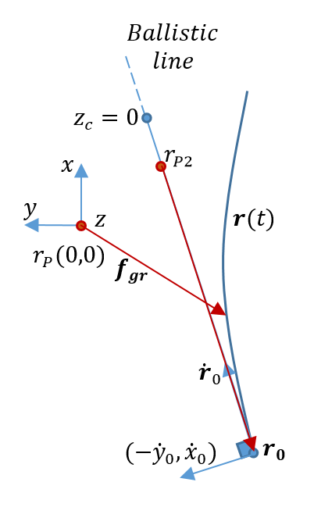

Result 1
The 3D VHIP with Fixed CoP only admits a 1D region as the Capture Region, and it is the intersection of the 2D region below the ballistic trajectory with the solid ground.
Consider the variable $w$:
$$w=\left(x,y\right)∙\left(−\dot{y},\dot{x}\right)=\dot{x}y−\dot{y}x$$
$$\dot{w}=0$$
We need $w→w_{f}=0$, so we need permanent $w\left(t\right)=w_{f} ∀t$. We have necessarily:
$$\frac{\dot{x}}{\dot{y}}=\frac{x}{y}$$

Slide 6
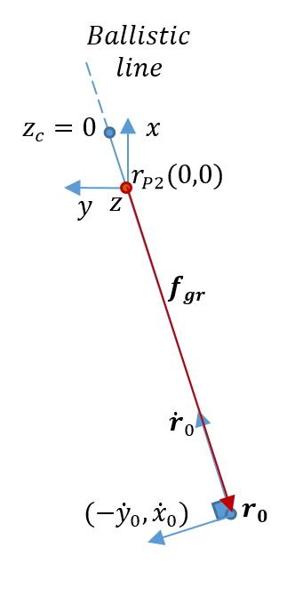

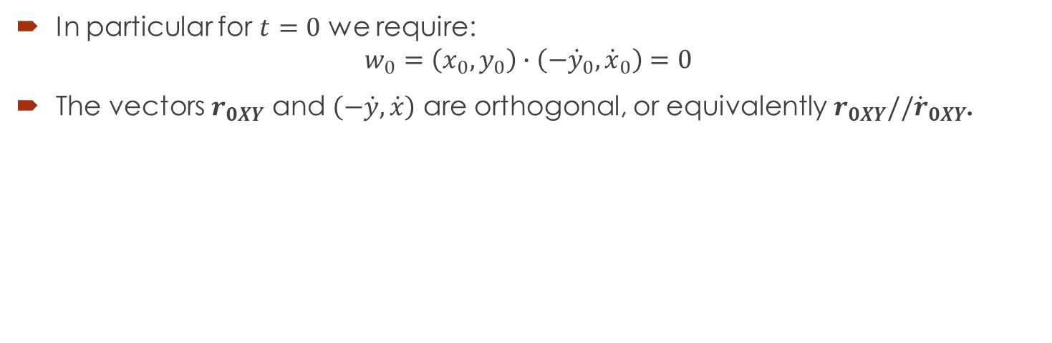





Result 1
In particular for $t=0$ we require:
$$w_{0}=\left(x_{0},y_{0}\right)∙\left(−{\dot{y}}_{0},{\dot{x}}_{0}\right)=0$$
The vectors $r_{0XY}$ and $\left(−\dot{y},\dot{x}\right)$ are orthogonal, or equivalently$r_{0XY}//{\dot{r}}_{0XY}$.
$${\dot{r}}_{0}$$
$$z$$
$$Ballistic$$
$$line$$
$$y$$
$$x$$
$$z_{c}=0$$

Slide 7
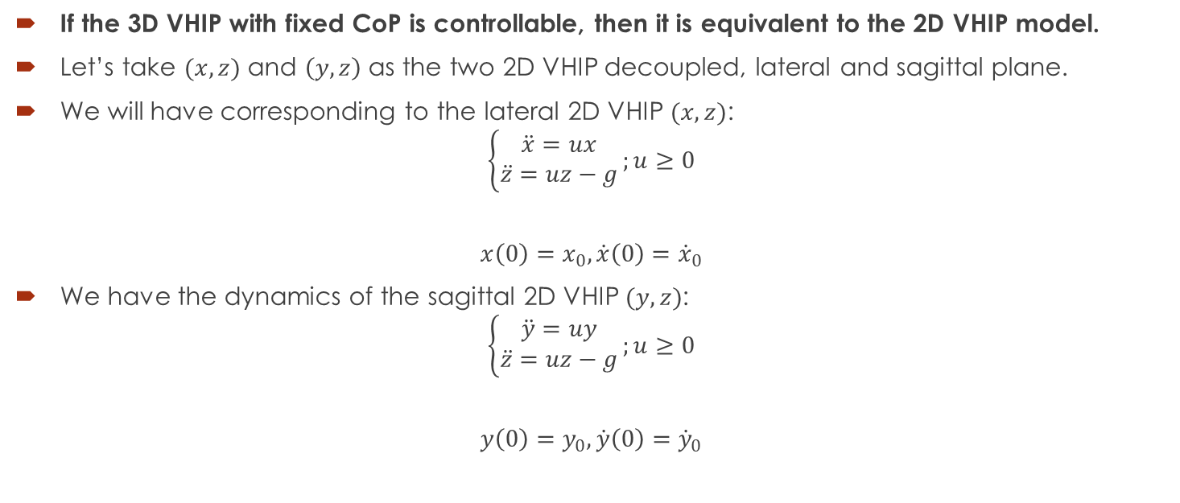
Result 2
If the 3D VHIP with fixed CoP is controllable, then it is equivalent to the 2D VHIP model.
Let’s take $(x,z)$ and $\left(y,z\right)$ as the two 2D VHIP decoupled, lateral and sagittal plane.
We will have corresponding to the lateral 2D VHIP $(x,z)$:
$$\left\{\begin{aligned}\ddot{x}=ux \\ \ddot{z}=uz−g\end{aligned}\right.;u≥0$$
$$x\left(0\right)=x_{0},\dot{x}\left(0\right)={\dot{x}}_{0}$$
We have the dynamics of the sagittal 2D VHIP $(y,z)$:
$$\left\{\begin{aligned}\ddot{y}=uy \\ \ddot{z}=uz−g\end{aligned}\right.;u≥0$$
$$y\left(0\right)=y_{0},\dot{y}\left(0\right)={\dot{y}}_{0}$$

Slide 8
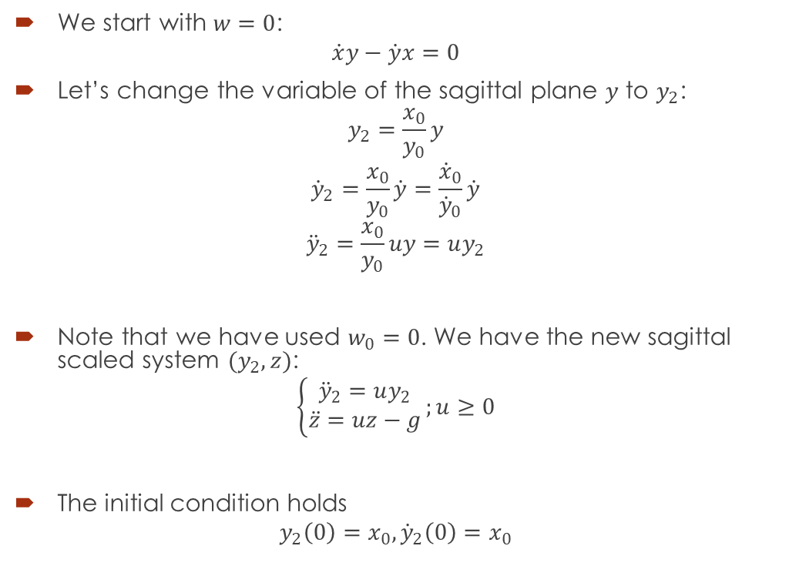




Result 2
We start with $w=0$:
$$\dot{x}y−\dot{y}x=0$$
Let’s change the variable of the sagittal plane $y$ to $y_{2}$:
$$y_{2}=\frac{x_{0}}{y_{0}}y$$
$${\dot{y}}_{2}=\frac{x_{0}}{y_{0}}\dot{y}=\frac{{\dot{x}}_{0}}{{\dot{y}}_{0}}\dot{y}$$
$${\ddot{y}}_{2}=\frac{x_{0}}{y_{0}}uy=uy_{2}$$
Note that we have used $w_{0}=0$. We have the new sagittal scaled system $(y_{2},z)$:
$$\left\{\begin{aligned}{\ddot{y}}_{2}=uy_{2} \\ \ddot{z}=uz−g\end{aligned}\right.;u≥0$$
The initial condition holds
$$y_{2}\left(0\right)=x_{0},{\dot{y}}_{2}\left(0\right)=x_{0}$$
$${\dot{r}}_{0}$$
$$z$$
$$y$$
$$x$$

Slide 9

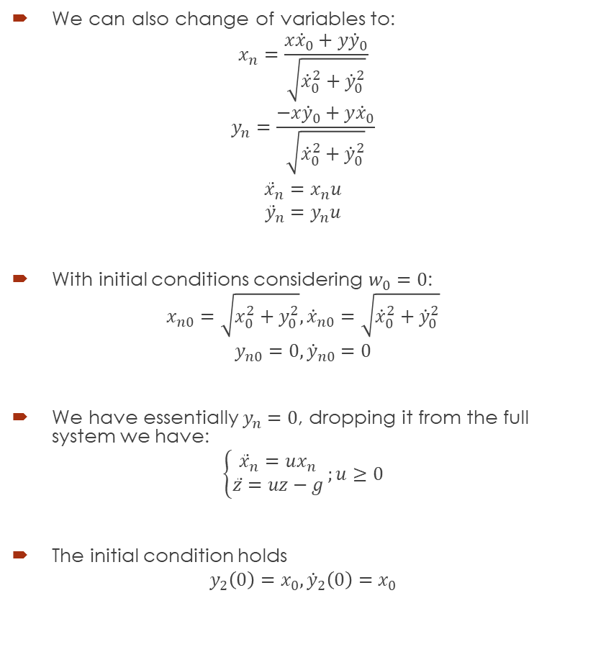


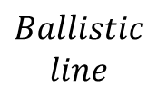




Result 2
We can also change of variables to:
$$x_{n}=\frac{x{\dot{x}}_{0}+y{\dot{y}}_{0}}{\sqrt{{\dot{x}}_{0}^{2}+{\dot{y}}_{0}^{2}}}$$
$$y_{n}=\frac{−x{\dot{y}}_{0}+y{\dot{x}}_{0}}{\sqrt{{\dot{x}}_{0}^{2}+{\dot{y}}_{0}^{2}}}$$
$${\ddot{x}}_{n}=x_{n}u$$
$${\ddot{y}}_{n}=y_{n}u$$
With initial conditions considering $w_{0}=0$:
$$x_{n0}=\sqrt{x_{0}^{2}+y_{0}^{2}},{\dot{x}}_{n0}=\sqrt{{\dot{x}}_{0}^{2}+{\dot{y}}_{0}^{2}}$$
$$y_{n0}=0,{\dot{y}}_{n0}=0$$
We have essentially $y_{n}=0$, dropping it from the full system we have:
$$\left\{\begin{aligned}{\ddot{x}}_{n}=ux_{n} \\ \ddot{z}=uz−g\end{aligned}\right.;u≥0$$
The initial condition holds
$$y_{2}\left(0\right)=x_{0},{\dot{y}}_{2}\left(0\right)=x_{0}$$
$${\dot{r}}_{0}$$
$$z_{n}$$
$$z$$
$$y$$
$$Ballistic$$
$$line$$
$$x_{n}$$
$$x$$
$$z_{c}=0$$

Slide 10

3D VHIP with Variable CoP
We have the full dynamical system as the 3D VHIP with Variable CoP:
$$\left\{\begin{aligned}\ddot{x}=u(x−x_{P}) \\ \ddot{y}=u(y−y_{P}) \\ \ddot{z}=u\left(z−z_{P}\right)−g\end{aligned}\right.;u≥0$$
Where $\left(x_{P},y_{P},z_{P}\right)∈CS$ are the coordinates of the Center of Pressure of the foot, which can be considered as control inputs along with $u$. $CS$ is the contact surface where the reaction force of the ground can be applied.

Slide 11
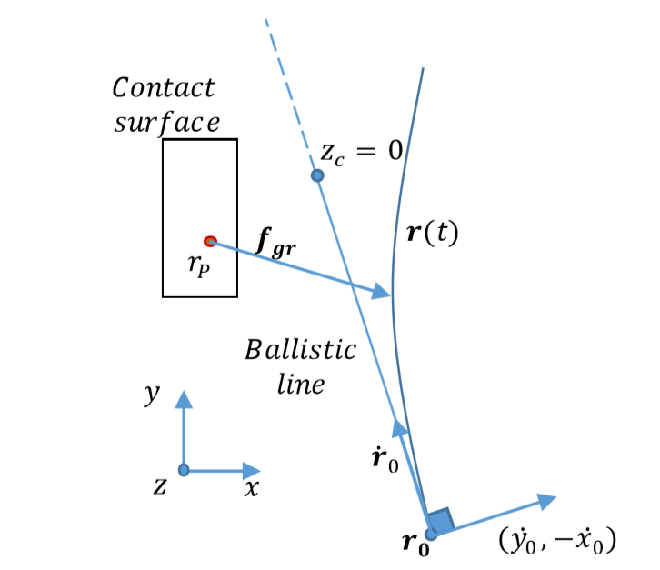
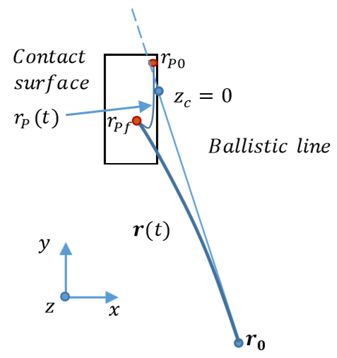
Result 3
In the 3D VHIP with variable CoP, the foot must have a non-empty intersection with the ballistic line in the plane (𝑥,𝑦). Otherwise, the system will be uncontrollable. Moreover, if the foot intersects the 2D region below the ballistic trajectory, then the system is controllable and can be controlled as the 2D VHIP with fixed CoP.

Slide 12
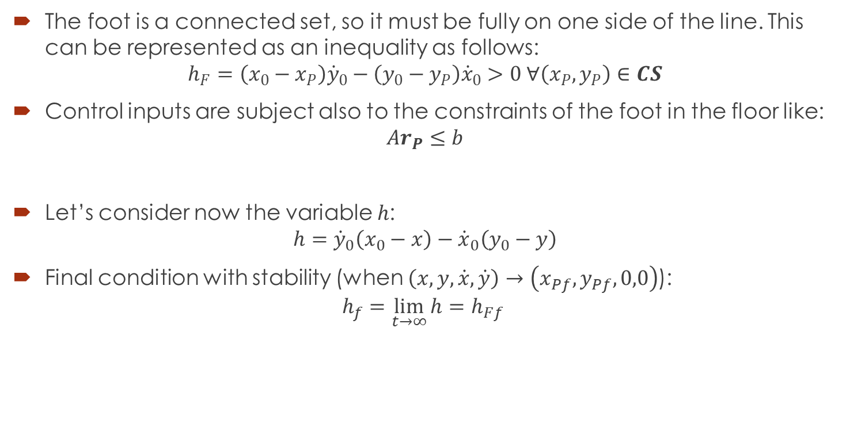
The foot is a connected set, so it must be fully on one side of the line. This can be represented as an inequality as follows:
$$h_{F}=\left(x_{0}−x_{P}\right){\dot{y}}_{0}−\left(y_{0}−y_{P}\right){\dot{x}}_{0}>0 ∀\left(x_{P},y_{P}\right)∈CS$$
Control inputs are subject also to the constraints of the foot in the floor like:
$$Ar_{P}≤b$$
Let’s consider now the variable $h$:
$$h={\dot{y}}_{0}\left(x_{0}−x\right)−{\dot{x}}_{0}\left(y_{0}−y\right)$$
Final condition with stability (when $\left(x,y,\dot{x},\dot{y}\right)→\left(x_{Pf},y_{Pf},0,0\right)$):
$$h_{f}=\lim_{t→∞}{h}=h_{Ff}$$

Slide 13

Dynamics of $h$:
$$\dot{h}={\dot{x}}_{0}\dot{y}−{\dot{y}}_{0}\dot{x}$$
$$\ddot{h}=\left({\dot{x}}_{0}\left(y−y_{P}\right)−{\dot{y}}_{0}\left(x−x_{P}\right)\right)u$$
$$\ddot{h}=\left(h−h_{F}\right)u$$
Initial conditions hold:
$$h_{0}=0, {\dot{h}}_{0}=0, {\ddot{h}}_{0}≤0$$
But we require eventually:
$$h_{f}=h_{Pf}>0$$

Slide 14
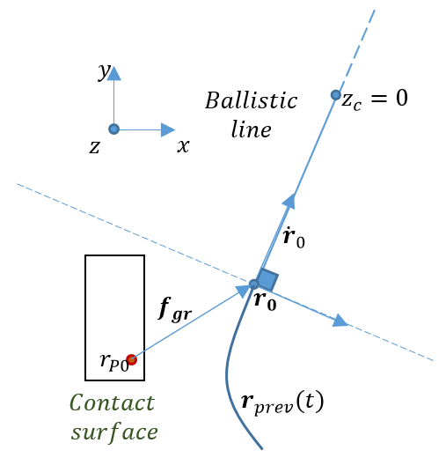
Result 4
Equivalence of a requirement from the 2D VHIP to the 3D VHIP:
In the 3D VHIP with variable CoP, the contact surface must have at least one point placed forward in the direction of the push.

Slide 15
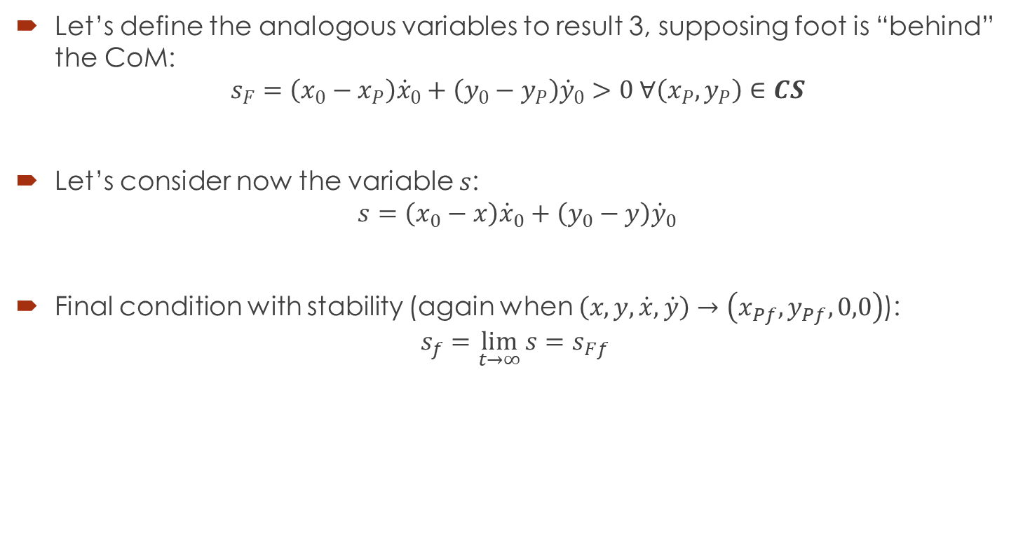
Let’s define the analogous variables to result 3, supposing foot is “behind” the CoM:
$$s_{F}=\left(x_{0}−x_{P}\right){\dot{x}}_{0}+\left(y_{0}−y_{P}\right){\dot{y}}_{0}>0 ∀\left(x_{P},y_{P}\right)∈CS$$
Let’s consider now the variable $s$:
$$s=\left(x_{0}−x\right){\dot{x}}_{0}+\left(y_{0}−y\right){\dot{y}}_{0}$$
Final condition with stability (again when $\left(x,y,\dot{x},\dot{y}\right)→\left(x_{Pf},y_{Pf},0,0\right)$):
$$s_{f}=\lim_{t→∞}{s}=s_{Ff}$$

Slide 16

Dynamics of $s$:
$$\dot{s}=−{\dot{x}}_{0}\dot{x}−{\dot{y}}_{0}\dot{y}$$
$$\ddot{s}=−\left({\dot{x}}_{0}\left(x−x_{P}\right)+{\dot{y}}_{0}\left(y−y_{P}\right)\right)u$$
$$\ddot{s}=\left(s−s_{F}\right)u$$
Initial conditions hold:
$$s_{0}=0, {\dot{s}}_{0}<0, {\ddot{s}}_{0}≤0$$
But we require eventually:
$$s_{f}=s_{Pf}>0$$

Slide 17
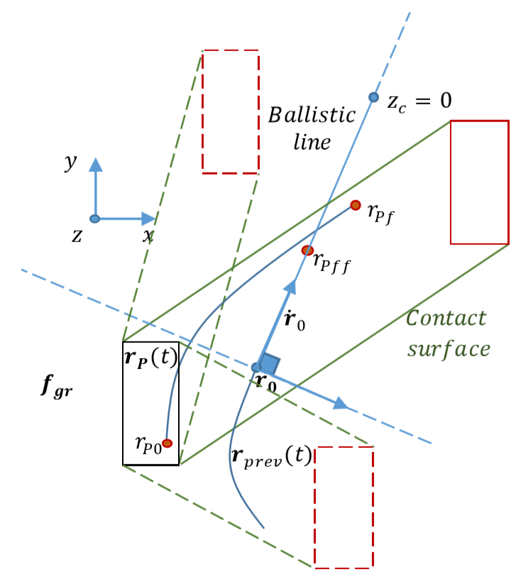
Extra
Relation with the last step of an n-step recovery:
In the case of the last step of n-step recovery, we no longer require the foot stepping over the ballistic line, but we need the new Contact surface, i.e. the convex hull of the feet, containing the ballistic line.

Slide 18

INCREASING CR FROM 3D LIP
CR for 3D LIP with Variable CoP:
3D VHIP
$$\left\{\begin{aligned}\ddot{x}=u(x−x_{P}) \\ \ddot{y}=u(y−y_{P}) \\ \ddot{z}=u\left(z−z_{P}\right)−g\end{aligned}\right.;u≥0$$
3D LIP $u=\frac{g}{z_{f}−z_{P}}$ and $\dot{z}=0$
$$\left\{\begin{aligned}\ddot{x}=u(x−x_{P}) \\ \ddot{y}=u(y−y_{P})\end{aligned}\right.$$
$ω_{0}=\sqrt{\frac{g}{z_{f}−z_{P}}}$

Slide 19

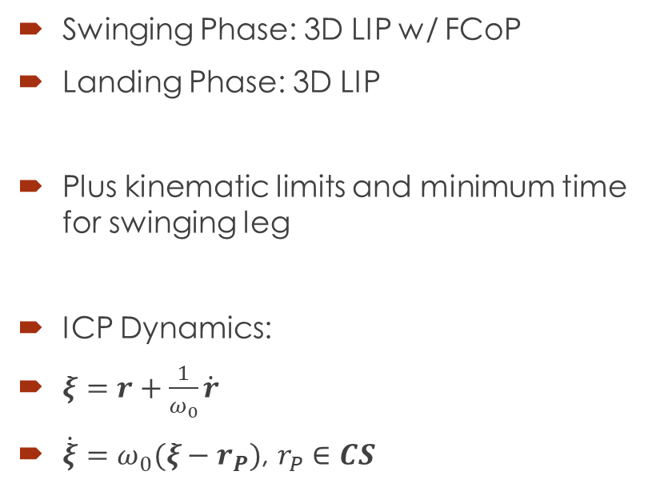
CR with Flat terrain
Swinging Phase: 3D LIP w/ FCoP
Landing Phase: 3D LIP
Plus kinematic limits and minimum time for swinging leg
ICP Dynamics:
$ξ=r+\frac{1}{ω_{0}}\dot{r}$
$\dot{ξ}=ω_{0}(ξ−r_{P})$, $r_{P}∈CS$
CR
KL
ICP
MT
$$r_{P}$$

Slide 20


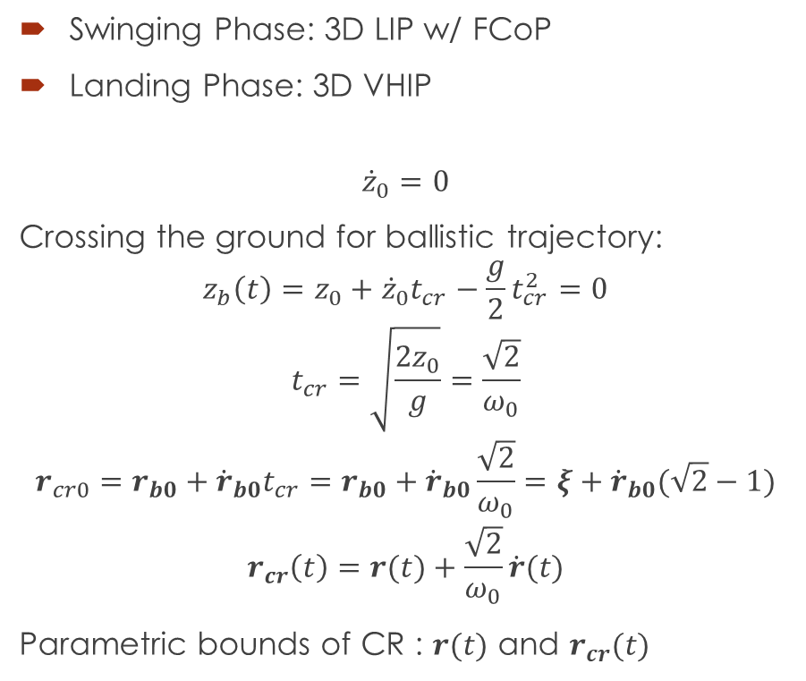



CR with Flat terrain
Swinging Phase: 3D LIP w/ FCoP
Landing Phase: 3D VHIP
$${\dot{z}}_{0}=0$$
Crossing the ground for ballistic trajectory:
$$z_{b}\left(t\right)=z_{0}+{\dot{z}}_{0}t_{cr}−\frac{g}{2}t_{cr}^{2}=0$$
$$t_{cr}=\sqrt{\frac{2z_{0}}{g}}=\frac{\sqrt{2}}{ω_{0}}$$
$$r_{cr0}=r_{b0}+{\dot{r}}_{b0}t_{cr}=r_{b0}+{\dot{r}}_{b0}\frac{\sqrt{2}}{ω_{0}}=ξ+{\dot{r}}_{b0}(\sqrt{2}−1)$$
$$r_{cr}\left(t\right)=r(t)+\frac{\sqrt{2}}{ω_{0}}\dot{r}(t)$$
Parametric bounds of CR : $r(t)$ and $r_{cr}(t)$
KL
$$z_{c}≥0$$
MT
$$r_{cr0}$$
ICP
$$T≥0$$
$${\dot{r}}_{0}$$
$$r_{P}$$
$$r_{0}$$

Slide 21

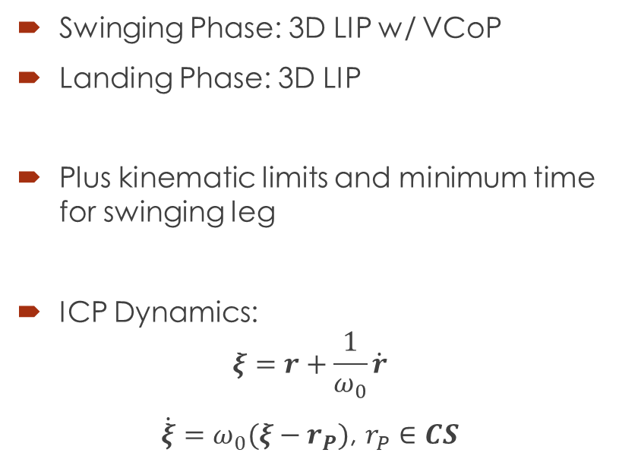
CR with Flat terrain
Swinging Phase: 3D LIP w/ VCoP
Landing Phase: 3D LIP
Plus kinematic limits and minimum time for swinging leg
ICP Dynamics:
$$ξ=r+\frac{1}{ω_{0}}\dot{r}$$
$\dot{ξ}=ω_{0}(ξ−r_{P})$, $r_{P}∈CS$
KL
ICP
MT
$$CS$$

Slide 22


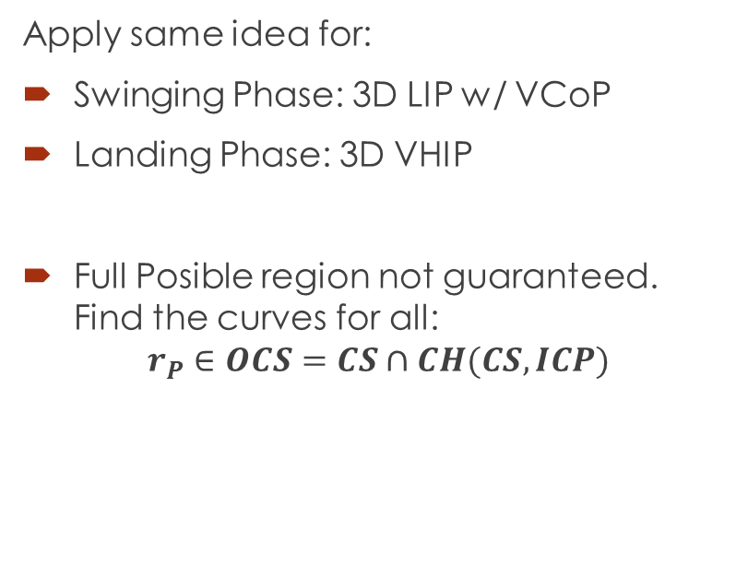



CR with Flat terrain
Apply same idea for:
Swinging Phase: 3D LIP w/ VCoP
Landing Phase: 3D VHIP
Full Posible region not guaranteed. Find the curves for all:
$$r_{P}∈OCS=CS∩CH(CS,ICP)$$
$$z_{c}≥0$$
$$r_{cr0}$$
ICP
$$T≥0$$
$$CS$$
$${\dot{r}}_{0}$$
$$OCS$$
$$r_{0}$$

Slide 23
CR with Flat terrain
Swinging Phase: 3D LIP w/ VCoP
Landing Phase: 3D VHIP
KL
$$r_{cr0}$$
ICP
MT
$$CS$$
$${\dot{r}}_{0}$$
$$r_{0}$$

Slide 24
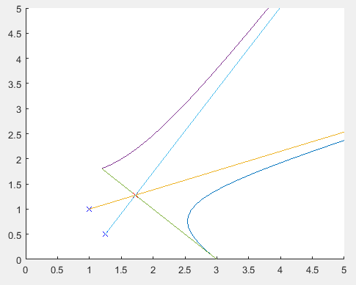
CR with Flat terrain
Swinging Phase: 3D LIP w/ VCoP
Landing Phase: 3D VHIP
KL
MT

Slide 25
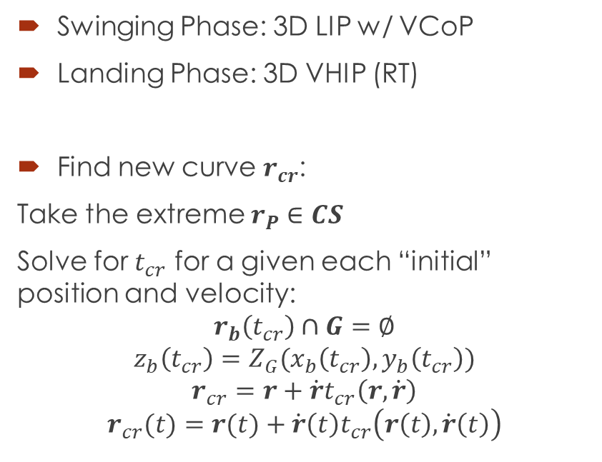
CR with Rough terrain
Swinging Phase: 3D LIP w/ VCoP
Landing Phase: 3D VHIP (RT)
Find new curve $r_{cr}$:
Take the extreme $r_{P}∈CS$
Solve for $t_{cr}$ for a given each “initial” position and velocity:
$$r_{b}\left(t_{cr}\right)∩G=∅$$
$$z_{b}\left(t_{cr}\right)=Z_{G}(x_{b}\left(t_{cr}\right),y_{b}\left(t_{cr}\right))$$
$$r_{cr}=r+\dot{r}t_{cr}\left(r,\dot{r}\right)$$
$$r_{cr}(t)=r(t)+\dot{r}\left(t\right)t_{cr}\left(r\left(t\right),\dot{r}\left(t\right)\right)$$
KL
$$r_{cr0}$$
ICP
MT
$$CS$$
$${\dot{r}}_{0}$$
$$r_{0}$$

Slide 26
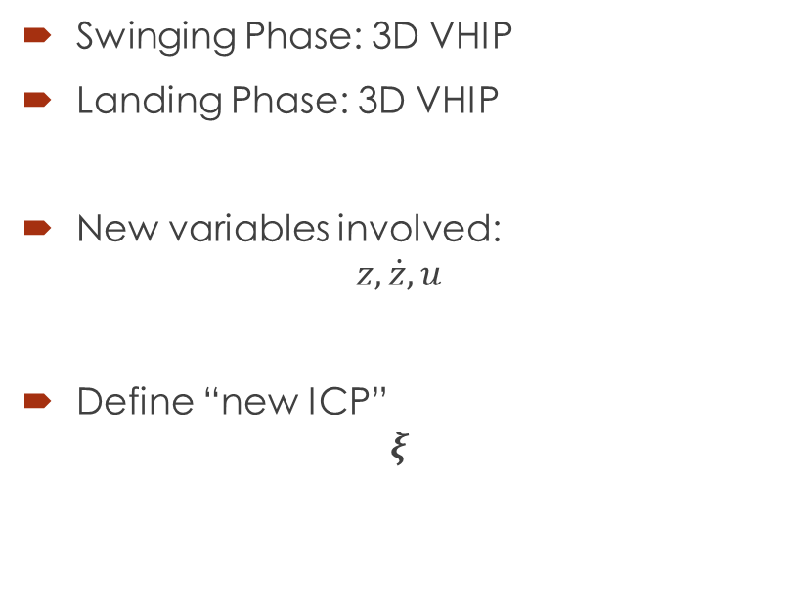
Next case of study:
Swinging Phase: 3D VHIP
Landing Phase: 3D VHIP
New variables involved:
$$z,\dot{z},u$$
Define “new ICP”
$$ξ$$
KL
CR
MT

Slide 27
Thank you!

Slide 28
REFERENCES
[1] R. Tedrake, «Underactuated Robotics | edX,» [En línea]. Available: https://www.edx.org/es/course/underactuated-robotics-mitx-6-832x-0. [Último acceso: 3 Octubre 2018].
[2] O. E. Ramos y K. Hauser, «Generalizations of the capture point to nonlinear center of mass paths and uneven terrain,» Humanoid Robots (Humanoids), 2015 IEEE-RAS 15th International Conference on, p. 851–858, Nov 2015.
[3] S. Kajita y K. Tani, «Study of dynamic biped locomotion on rugged terrain-derivation and application of the linear inverted pendulum mode.,» Proceeding of IEEE International Conference on Robotics and Automation (ICRA), vol. 2, pp. 1405-1411, 1991.
[4] S. Kajita, K. Tani y A. Kobayashi, «Dynamic Walk Control of a Biped Robot along the Potential Energy Conserving Orbit,» Proceedings of International Workshop on Intelligent Robots and System (IROS '90), pp. 789-794, 1990.
[5] J. E. Pratt y S. V. Drakunov, «Derivation and application of a conserved orbital energy for the inverted pendulum bipedal walking model,» Robotics and Automation, 2007 IEEE International Conference on, p. 4653–4660, Abril 2007.
[6] T. Koolen, M. Posa y R. Tedrake, «Balance control using center of mass height variation: limitations imposed by unilateral contact,» Humanoid Robots (Humanoids), 2016 IEEE-RAS 16th International Conference, pp. 8-15, 2016.

Slide 29
REFERENCES
[7] J. Pratt, J. Carff, S. Drakunov y A. Goswami, «Capture Point: A Step toward Humanoid Push Recovery,» Proceedings of the IEEE-RAS/RSJ International Conference on Humanoid Robots, pp. 200-207, 2006.
[8] S. Caron y A. Kheddar, «Dynamic Walking over Rough Terrains by Nonlinear Predictive Control of the Floating-base Inverted Pendulum,» 2017 IEEE/RSJ International Conference on Intelligent Robots and Systems (IROS), pp. 5017-5024, 2017.
[9] H. K. Khalil, «College of Engineering, Michigan State University,» [En línea]. Available: https://www.egr.msu.edu/~khalil/NonlinearSystems/Sample/Lect_19.pdf. [Último acceso: 02 Octubre 2018].
[10] J.-J. E. SLOTINE, Applied Nonlinear Control, New Jersey, USA: Prentice-Hall, 1991.
[11] S. Fadali, «University of Nevada, Reno - Wolfweb Websites,» University of Nevada, Reno, [En línea]. Available: https://wolfweb.unr.edu/~fadali/EE776/InputStateStab.pdf. [Último acceso: 03 Octubre 2018].

